Slide 1
MODULE 4 (list,tuple,dict,set)
Hemavathy S
SENSE

Slide 2
What is a set?
Mathematically, a set is a collection of items not in any particular order – unordered.
The elements in the set cannot be duplicates.
The elements in the set are immutable, but the set as a whole is mutable.
They do not support any indexing or slicing operation.
Sets are written with curly brackets {}.
Sets can have only immutable items inside like numbers,strings, tuples

Slide 3
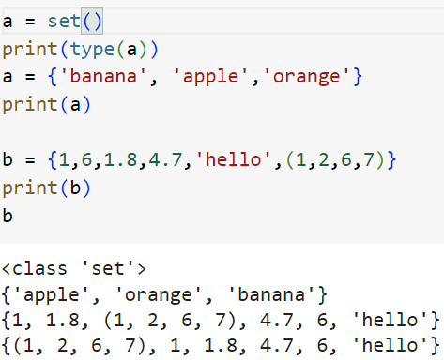
How to create a set?

Slide 4
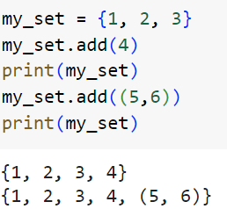
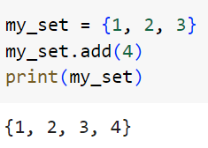
Set method
1. add()
Description: Adds a single element to a set.

Slide 5
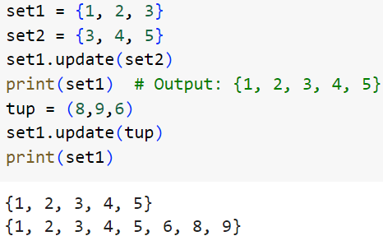
Set method
2. update()
Description: Adds elements from another set (or any iterable) to this set.

Slide 6
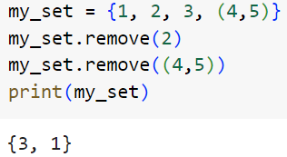
Set method
3. remove()
Description: Removes the specified element from the set. Raises a KeyError if the element is not found.

Slide 7
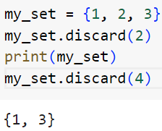
Set method
4. discard()
Description: Removes an element from a set if it is present. Does not raise an error if the element is not found.

Slide 8
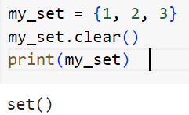
Set method
5. clear()
Description: Removes all elements from a set, making it an empty set.

Slide 9
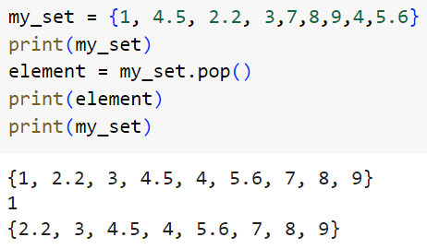
Set method
6. pop()
Description: Removes and returns a random element from the set. Raises an error if the set is empty.

Slide 10
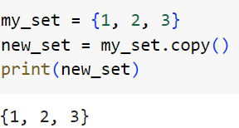
Set method
7. copy()
Description: Returns a shallow copy of the set.

Slide 11
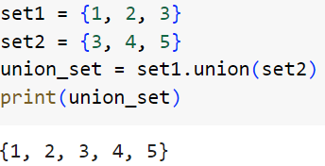
Set operation
8. union()
Description: Returns a set containing all elements from both sets (duplicates removed).

Slide 12
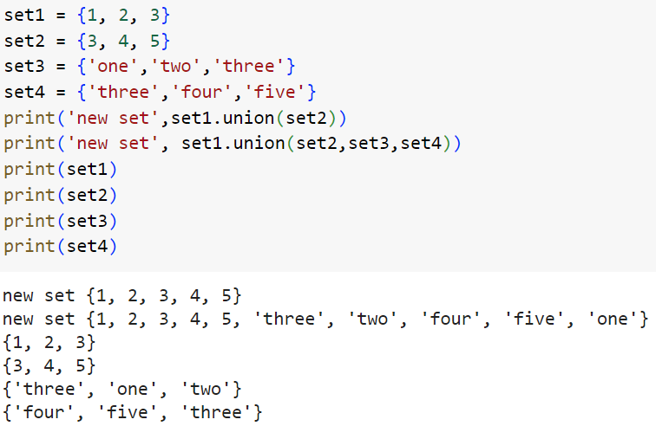

Slide 13
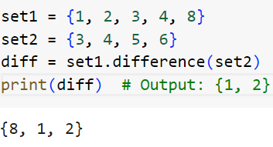
Set operation
9. difference()
Description: Returns a set containing the difference between two or more sets. It contains elements that are in the first set but not in the other(s).

Slide 14
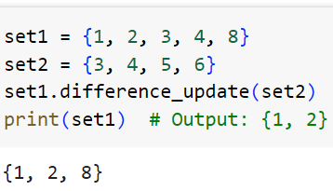
Set operation
10. difference_update()
Description: Removes all elements of another set from this set.

Slide 15
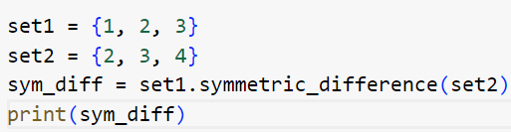
Set operation
11. symmetric_difference()
Description: Returns a set with elements that are in either of the sets but not in both.

Slide 16
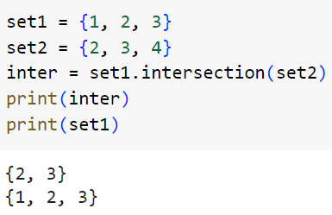
Set operation
12.symmetric_difference_update()
Description: Updates the set to include elements in either of the sets but not in both.

Slide 17
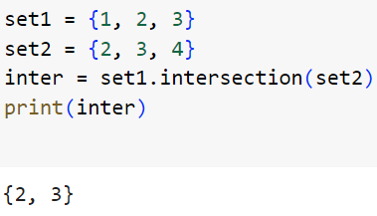
Set operation
13. intersection()
Description: Returns a set that contains only elements that are in both sets.

Slide 18
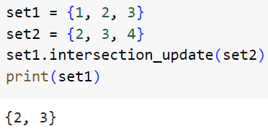
Set operation
14. intersection_update()
Description: Updates the set, keeping only elements found in it and another specified set.

Slide 19
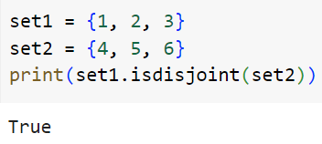
Set operation
15. isdisjoint()
Description: Returns True if two sets have no elements in common.

Slide 20
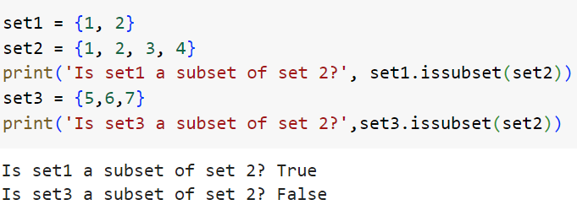
Set operation
16. issubset()
Description: Returns True if all elements of this set are present in another specified set.

Slide 21
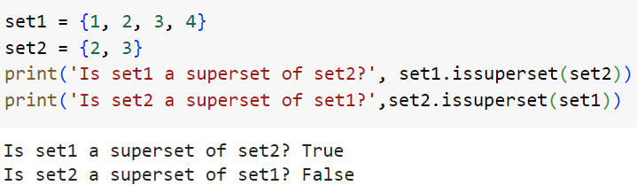
Set operation
17. issuperset()
Description: Returns True if this set contains all elements of another specified set.

Slide 22
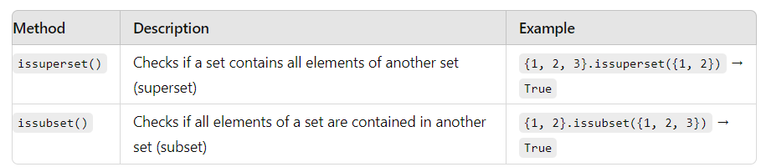

Slide 23
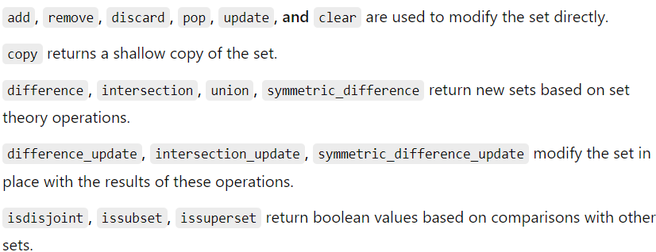

Slide 24
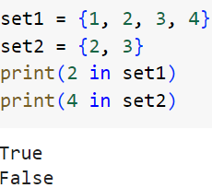
Set membership

Slide 25
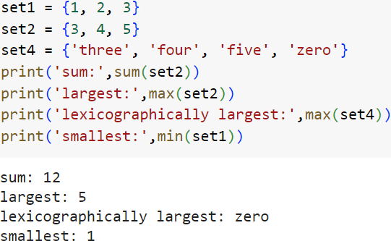
Other builtin function
sum()
max()
min()

Slide 26
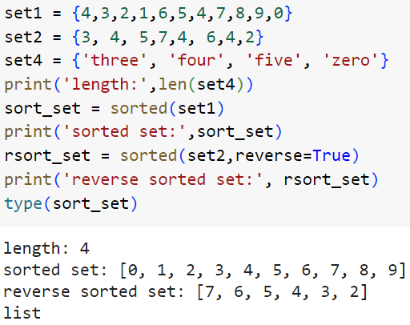
Other builtin function
len()
sorted()

